Slide 1




Trivia Maze Game
Team Triploblastic: Andrew M., Ana K., Kevin R., Kale S.

Slide 2

Code Overview:
4 Main Packages:
1. MazeGeneration
2. MazeGame
3. MazeRoomLogic
4. TriviaQuestions

Slide 3




MazeGeneration
Uses RoomType enums!
Adds communal logic
Uses Depth-First-Search Algorithm
Begin with a solid block
Carve a path for as long as possible.
Backtrack if you have to
Add gates along the way
Place your start and exit

Slide 4
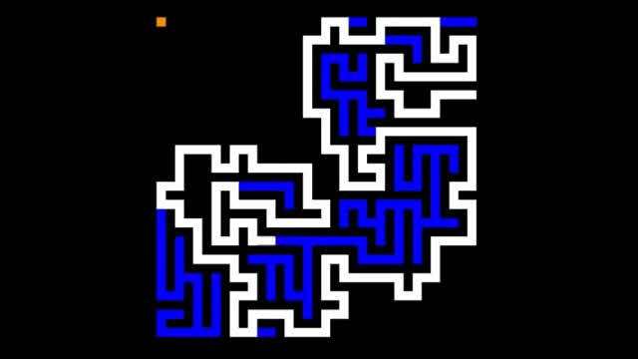

Slide 5

MazeGame
Some kid from helped us out!
But we did soooo much more…
Maze
Board
Map
MazeParser.parseMaze(map)

Slide 6

…we parsed the maze into MazeNodes!
MazeNodes reference nothing beyond their immediate neighbors.
They don’t know they are a part of something bigger (ie the Board)

Slide 7
Each MazeNode has a MazeRoom.
Each MazeRoom has a BEHAVIOR
Specifically, each MazeRoom has an…
EnterBehavior

Slide 8

Here, drink this.
Giving the MazeRooms behaviors simplifies the Player object
The Player becomes a true pawn, who’s attributes are acted on by outside forces.

Slide 9
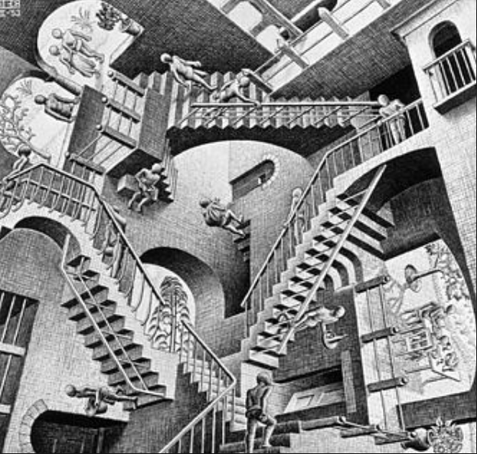
Those outside forces are MazeRoomLogic

Slide 11

TriviaQuestions
Have a Prompt & AnswerSet
The prompt is mostly GUI.
The answerSet is mostly Strings.
Generated by QuestionFactory
Has a DB Manager

Slide 12
Insert demo here

